Slide 1





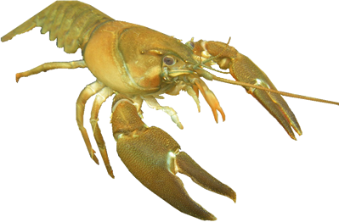
Crayfish + Freshwater Ecosystems
Notes:
Signal crayfish image by Jeff Benca; provided by his professor Dr. Eric Larson of the Univ. of Illinois
Pond illustration adapted with permission by Rick Reynolds, Engaging Every Student from Eric Engh, Marin / Sonoma Mosquito & Vector Control District.

Slide 2


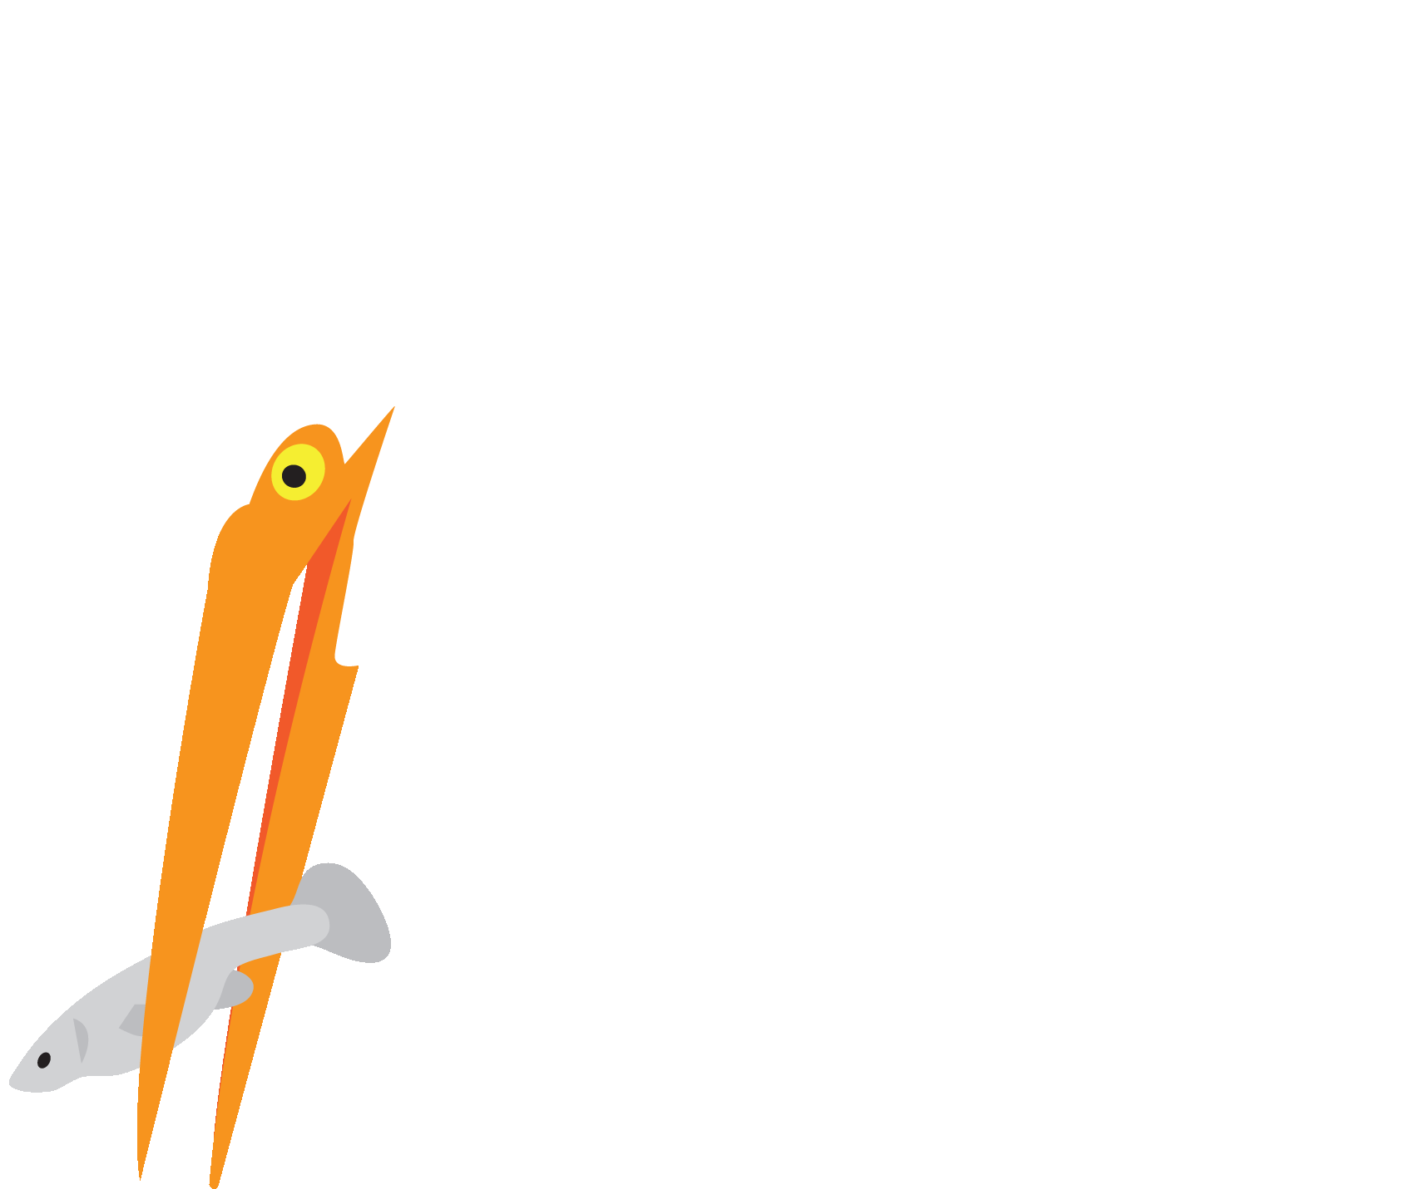

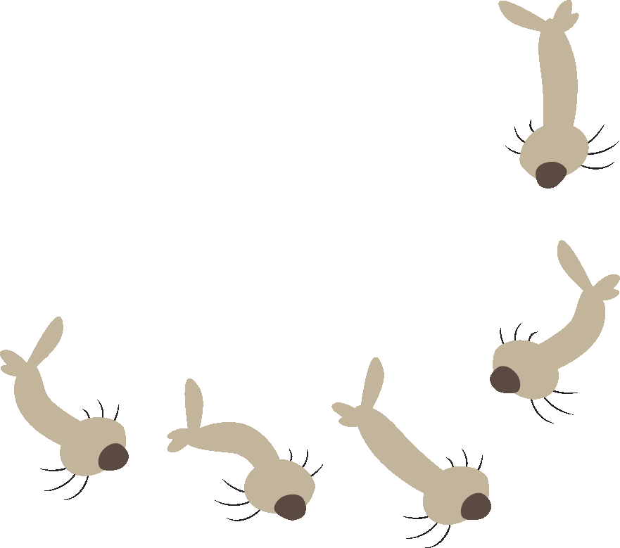


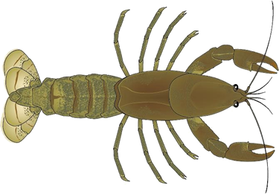
What energy source
supports life?
Producers
Consumers
Notes:
Ask the class to raise their hand if they know, “What is the energy source that supports life on Earth?” Wait for a number of hands to go up, and call on someone to say the Sun, then click to make it appear. Next ask why the Sun is so important for life on Earth. Discuss how it provides the energy which plants (producers) use to make food, and that the plants can then be food for animals (consumers) like insect larvae.
Most freshwater fish are predators which can eat insect larvae and other animals. Birds like egrets can eat the fish, continuing the food chain. If a fish dies, scavengers like crayfish can eat them.
Discuss how all the living and nonliving things are interconnected in an ecosystem—in this case a wetland ecosystem which is known for having a lot of biodiversity (different types of living things).
Graphic by Eric Engh, Marin / Sonoma Vector Control District and Rick Reynolds, Engaging Every Student

Slide 3
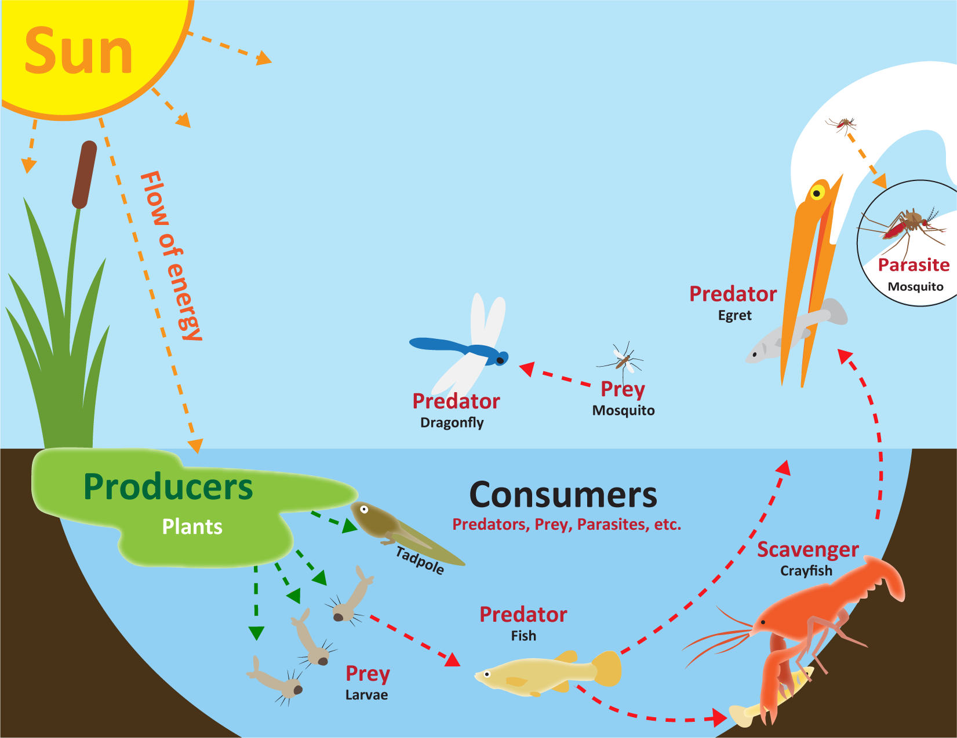
Freshwater Ecosystem
Notes:
Graphic by Eric Engh, Marin / Sonoma Vector Control District and Rick Reynolds, Engaging Every Student

Slide 4
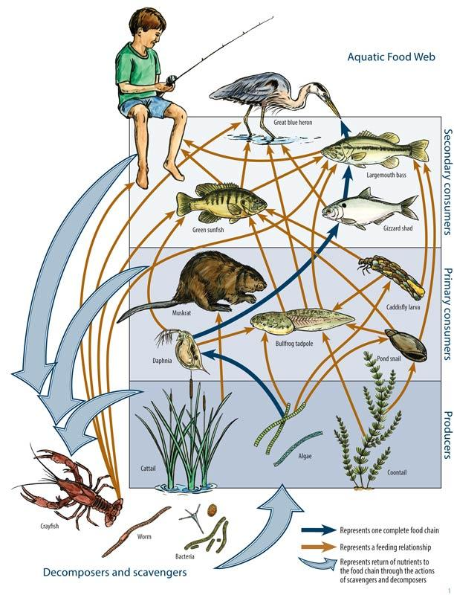
Notes:
Explain that organisms (living things) in an ecosystem interact in a food web, because they both eat and are eaten by other organisms.
Discuss the diagram and the different levels of interactions that it illustrates.
Diagram from Texas A&M Univ.: http://texasaquaticscience.org

Slide 5
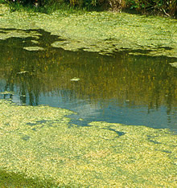
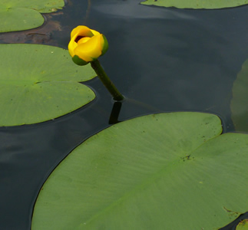
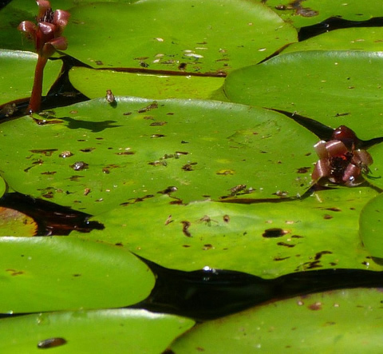
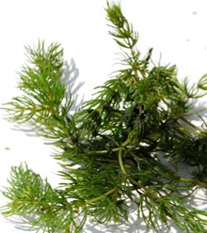
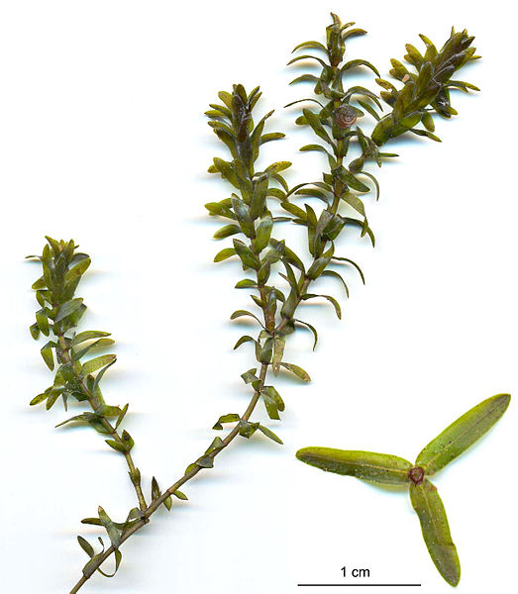
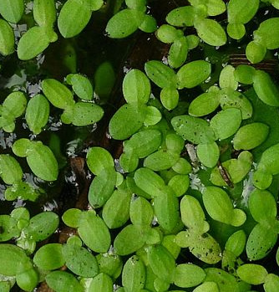
Plants
Algae
Yellow Waterlily
Nuphar polysepala
Water Shield
Brasenia schreberi
Coontail
Ceratophyllum demersum
Duckweed
Lemna minor
American Waterweed
Elodea canadensis
Notes:
Image Sources (all licensed for noncommercial reuse):
Algae: https://commons.wikimedia.org/wiki/File:CSIRO_ScienceImage_4628_Bluegreen_algae_in_irrigation_drain.jpg
American waterweed: https://commons.wikimedia.org/wiki/File:ElodeaCanadensis.jpg
Coontail: https://www.flickr.com/photos/29388462@N06/5060473519
Duckweed: https://commons.wikimedia.org/wiki/File:Common_Duckweed_(Lemna_minor).jpg
Water shield: https://c1.staticflickr.com/7/6012/5951233714_a84aeceea0_b.jpg
Yellow waterlily: https://www.flickr.com/photos/rusty_clark/6151512675

Slide 6
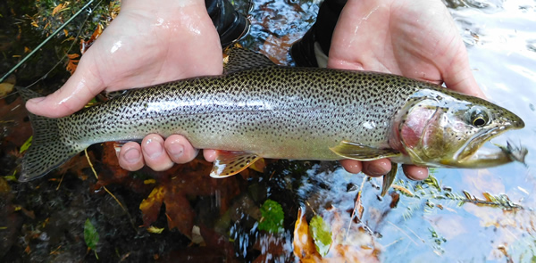
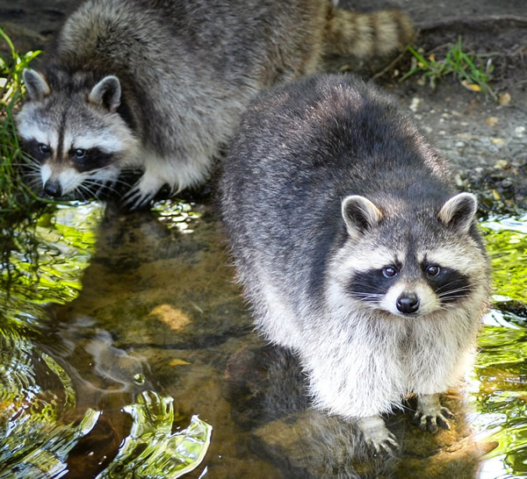
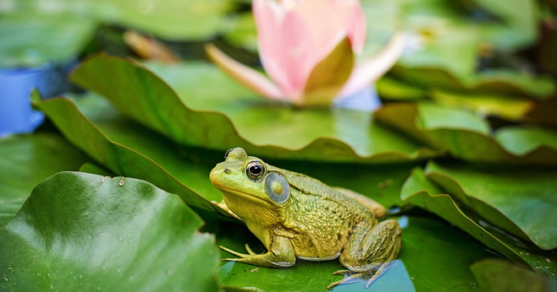
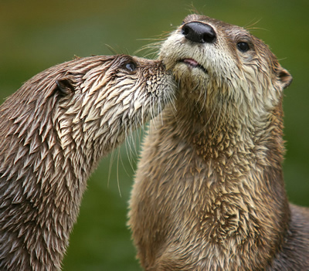
Many Animals Eat Crayfish
Trout
Raccoons
Frogs
River Otters
Notes:
Cutthroat trout:
https://upload.wikimedia.org/wikipedia/en/a/aa/Lake_Crescent_Cutthroat_Trout.jpg
Raccoons: https://pixabay.com/en/raccoon-cute-bear-funny-mammal-2498595/
Bullfrog: https://pixabay.com/en/bull-frog-green-pond-lily-pad-frog-2526024/
River otters: https://en.wikipedia.org/wiki/North_American_river_otter#/media/File:LutraCanadensis_fullres.jpg

Slide 7
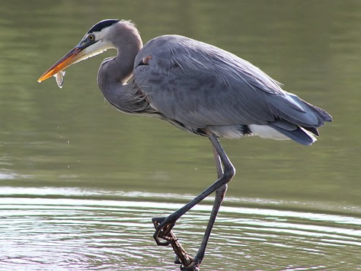
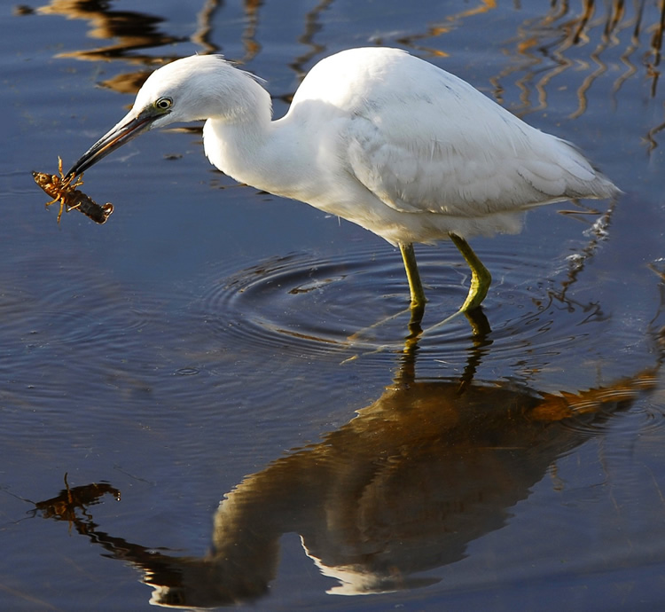
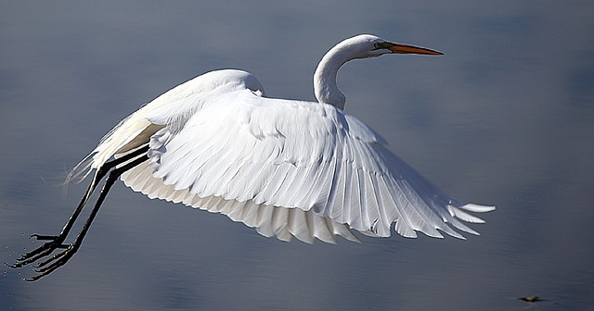
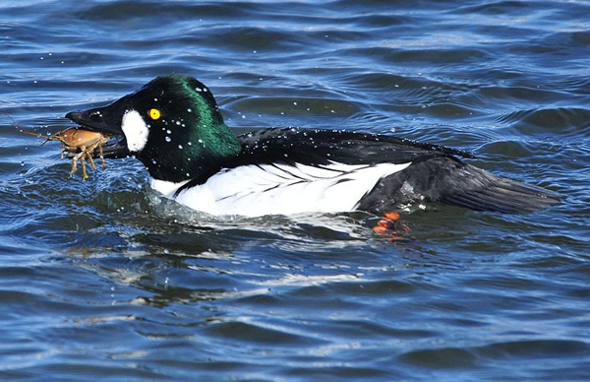
Great Blue Heron
Little Blue Heron (juvenile)
Great Egret
Common Goldeneye
Duck
Notes:
Some of the many birds that eat crayfish.
Photo sources (all have rights to distribute):
Great Blue Heron: https://pixabay.com/en/great-blue-heron-nature-bird-744257/
Little Blue Heron (juvenile, before it takes on its adult blue plumage):
https://upload.wikimedia.org/wikipedia/commons/0/0a/Little_Blue_Heron_%28_juvenile_%29_with_Crayfish_at_Lake_Woodruff_National_Wildlife_Refuge_-_Flickr_-_Andrea_Westmoreland.jpg
Common Goldeneye, which removed the claws before swallowing the rest of the crayfish whole: https://commons.wikimedia.org/wiki/File:Common_Goldeneye_with_Northern_Crayfish_on_Seedskadee_NWR_(24484242145).jpg

Slide 8
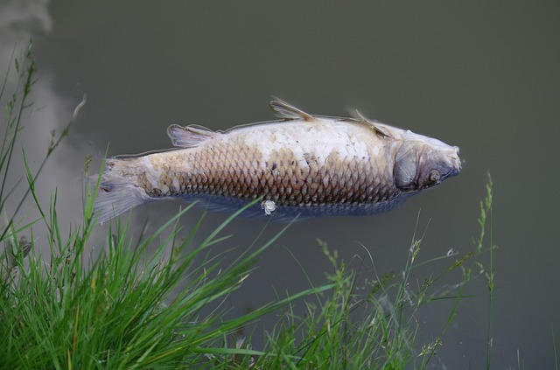
What Do Crayfish Eat?
Almost anything!
dead + living animals + plants
Notes:
Crayfish are omnivores that eat both dead and living plants and animals on river and lake bottoms; their role in reducing decaying matter and filtering the water is especially important for improving water quality. Predators as well as scavengers, crayfish—especially invasive, non-native species, can sometimes negatively impact ecosystems in other ways, as well. We will explore the positive and negative roles of crayfish more fully in later lessons.
Image Sources:
Signal crayfish image by Jeff Benca; provided by his professor Dr. Eric Larson of the Univ. of Illinois
Dead fish: https://pixabay.com/en/dead-fish-carcass-polluted-pond-1417882

Slide 9
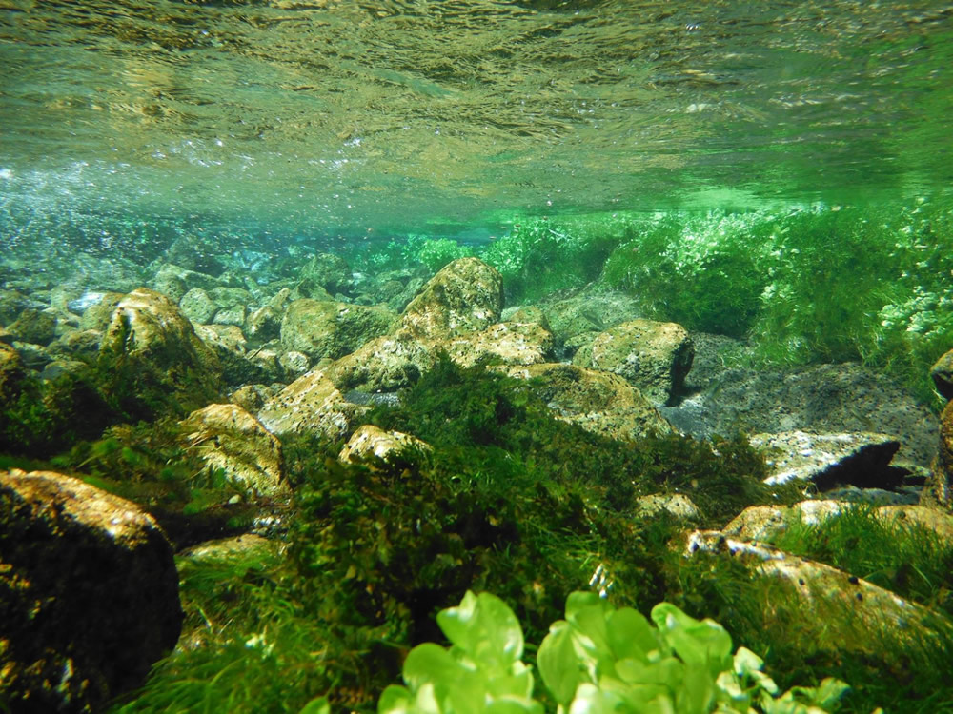
What do crayfish and other animals need to live?
Water
Oxygen
Food
Shelter
Space
Notes:
Image Source:
Freshwater spring by Eric Larson, Ph.D. of the Univ. of Illinois

Slide 10
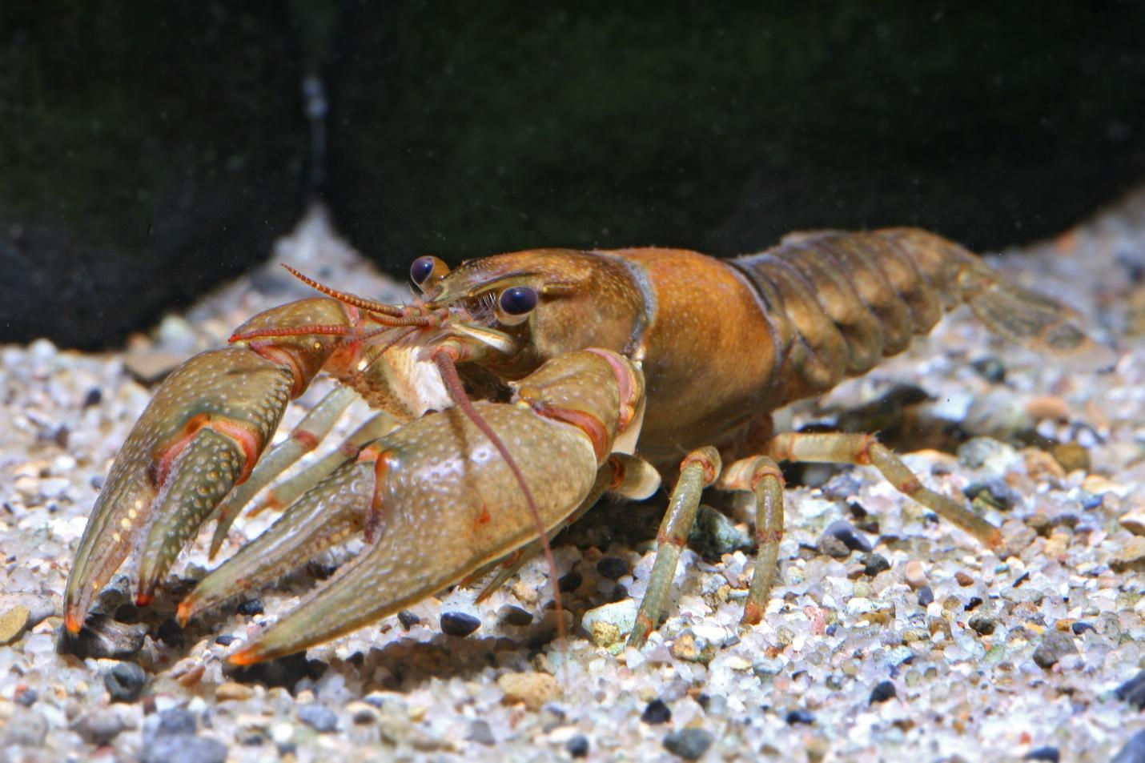
Northern Clearwater Crayfish
Notes:
Signal crayfish are native to the Pacific Northwest but non-native to the Great Lakes. Crayfish are crustaceans which are closely related to lobsters, their saltwater cousins, and they play an important role in freshwater ecosystems. They are an important food source for many species of fish, birds, amphibians, reptiles, and mammals, even those which spend much of their time on land, such as raccoons, so they can play important roles in terrestrial ecosystems, as well.
The vast majority of the more than 400 crayfish species are found in North America, especially the Southeastern U.S., although they can be found on every continent except Antarctica. Many species are at risk of extinction due to a variety of factors, such as habitat loss, pollution, and the spread of invasive crayfish species and disease (Larson 2018).
Signal crayfish image by Roger Tabor (U.S. Fish and Wildlife Service): https://www.flickr.com/photos/usfwspacific/6093365240 (licensed for noncommercial reuse)

