Slide 1
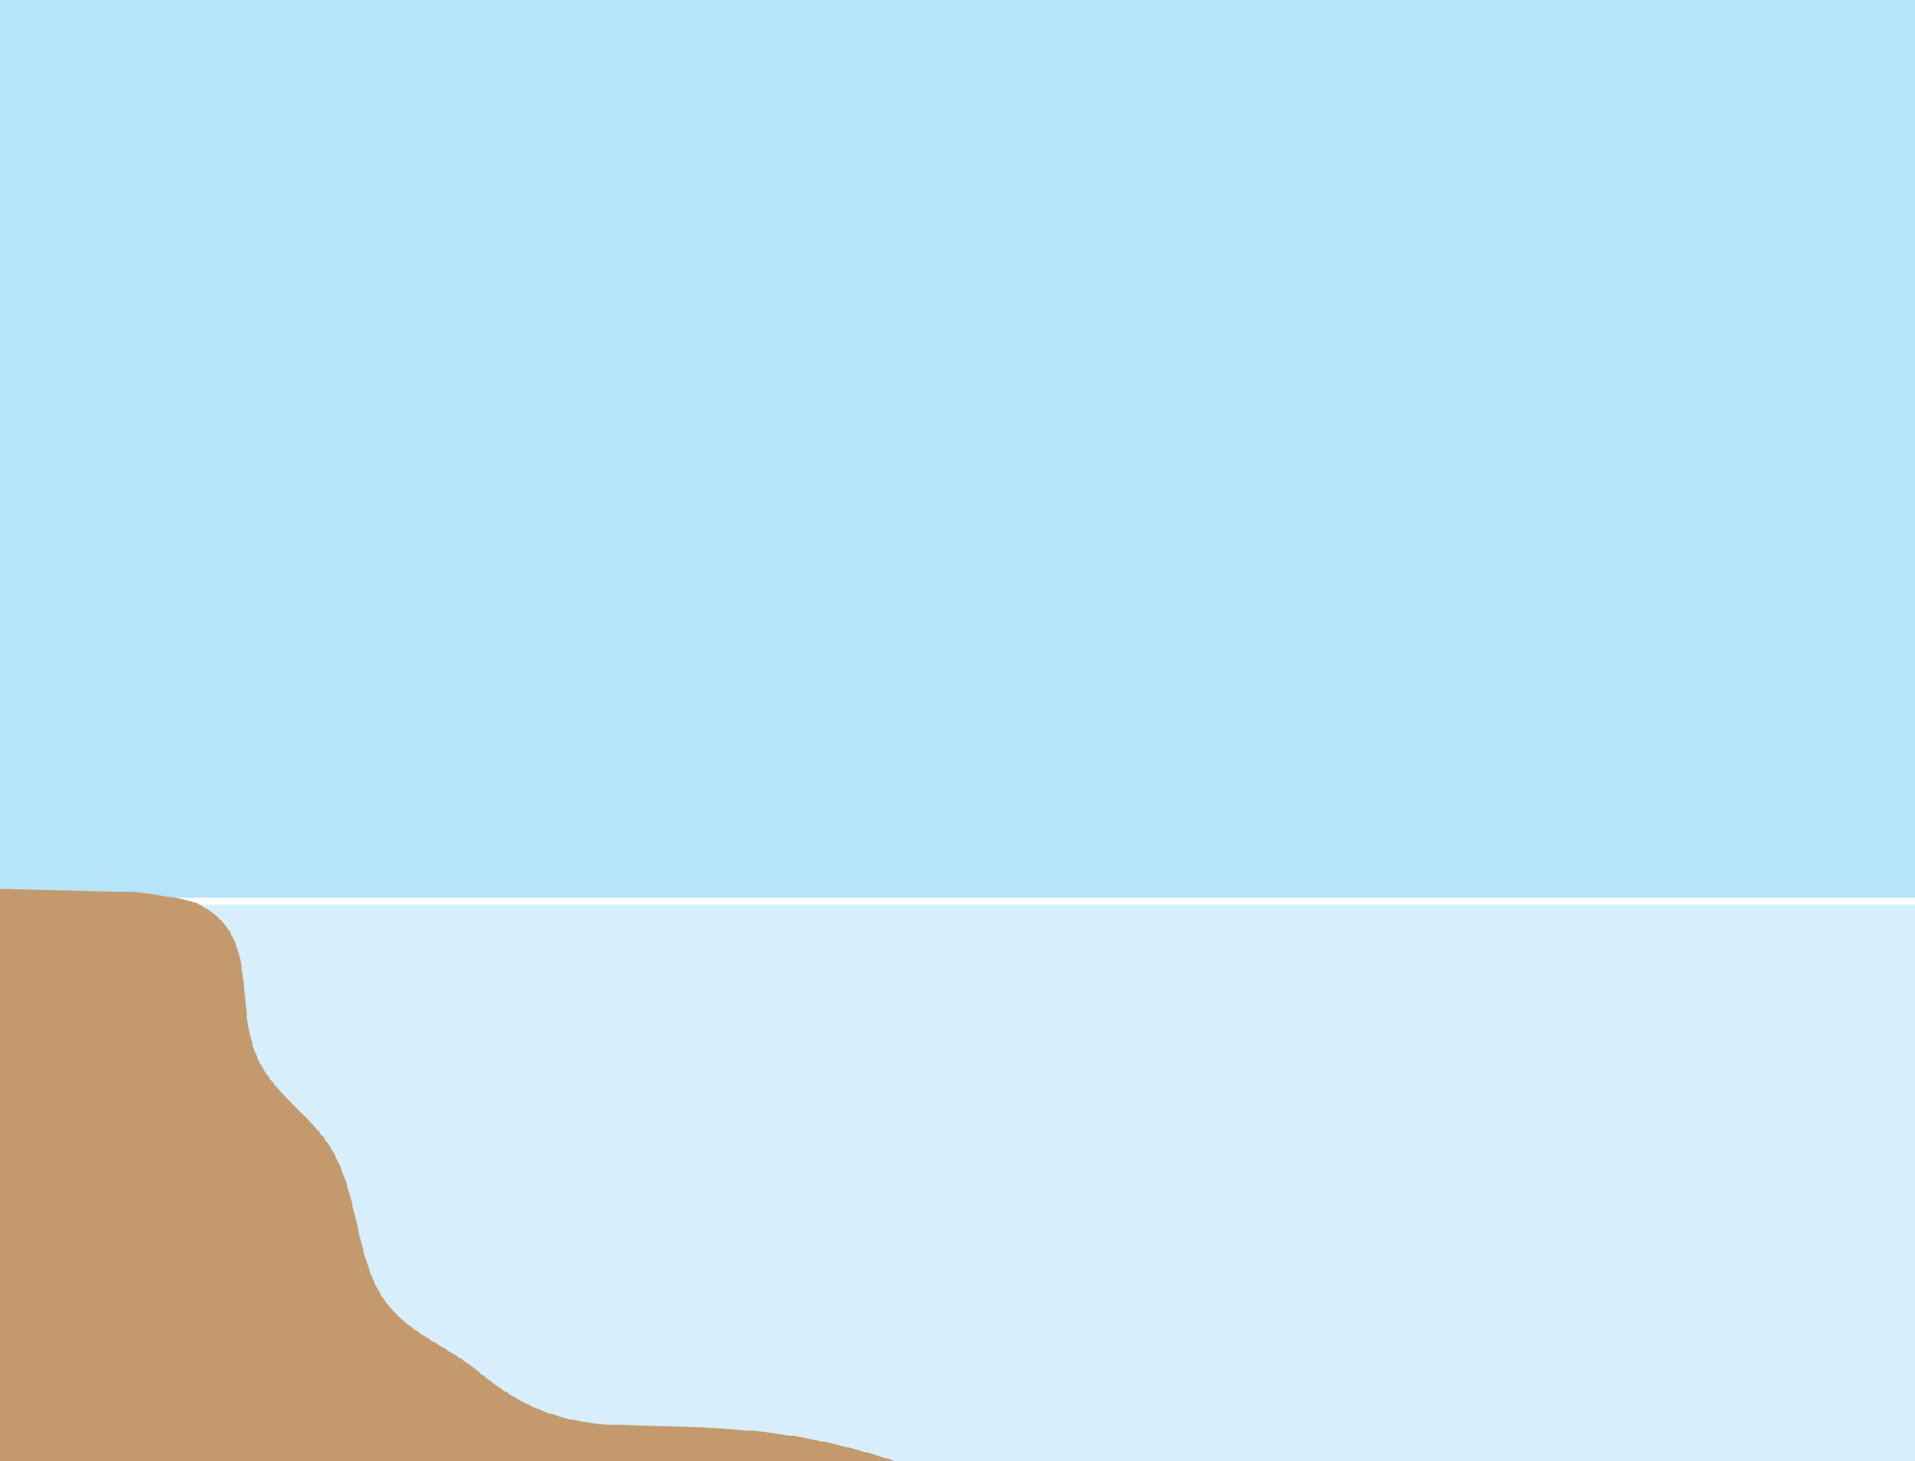
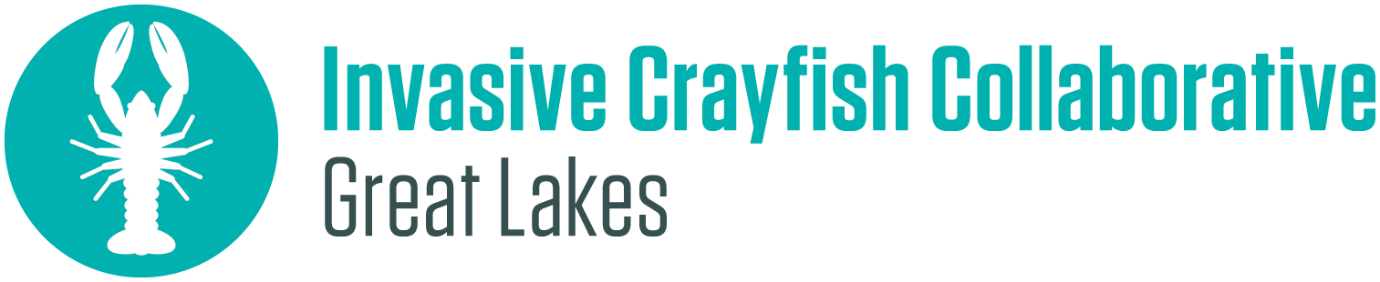
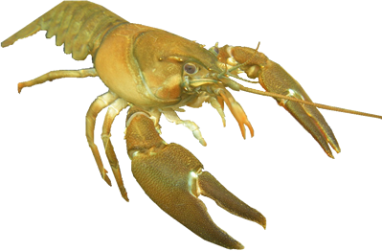
Crayfish Adaptations

Slide 2

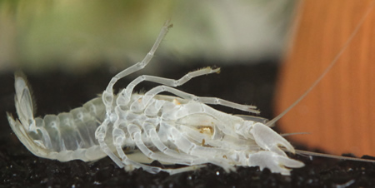
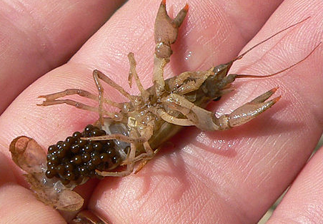
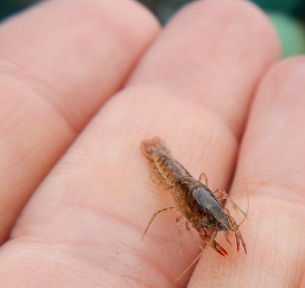
Adult
Crayfish
Life Cycle
Grows larger exoskeletons
+ sheds old ones (molting)
Tiny crayfish
Eggs
Notes:
Discuss life cycle
Tell students that crayfish have adaptations which help them survive at each stage of their life cycle.
Crayfish go through roughly 11 molts while they are growing.
Image Sources:
Eggs by Greg Hume: https://commons.wikimedia.org/wiki/File:CrayfishEggs.jpg
Tiny crayfish by Kimberly Emerson/U.S. Fish & Wildlife Service: https://www.flickr.com/photos/usfwsmidwest/25867149202
White crayfish exoskeleton: https://commons.wikimedia.org/wiki/File:Old_Exoskeleton_of_a_White_Crayfish_(Procambarus_sp.)_after_Moulting.jpg

Slide 3
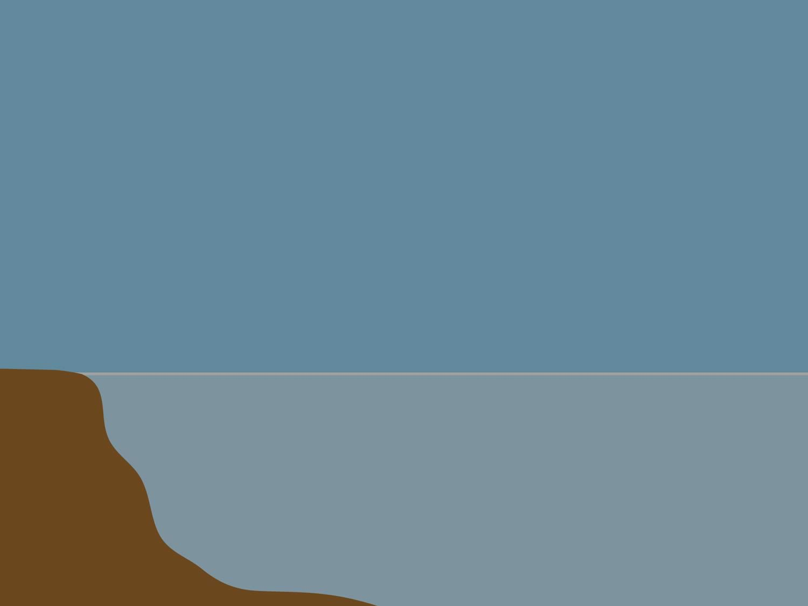

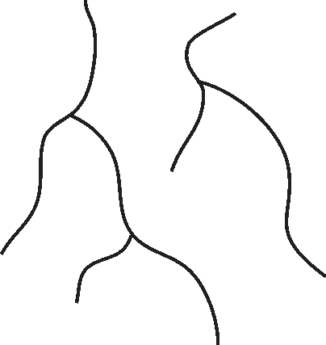

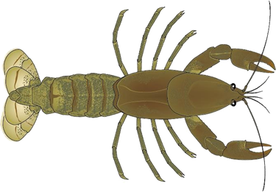
Most Active at Night (nocturnal)
Notes:
Discuss how crayfish are most active at night, and how that might help them to survive. (Less visible to predators, cooler, etc.)

Slide 4
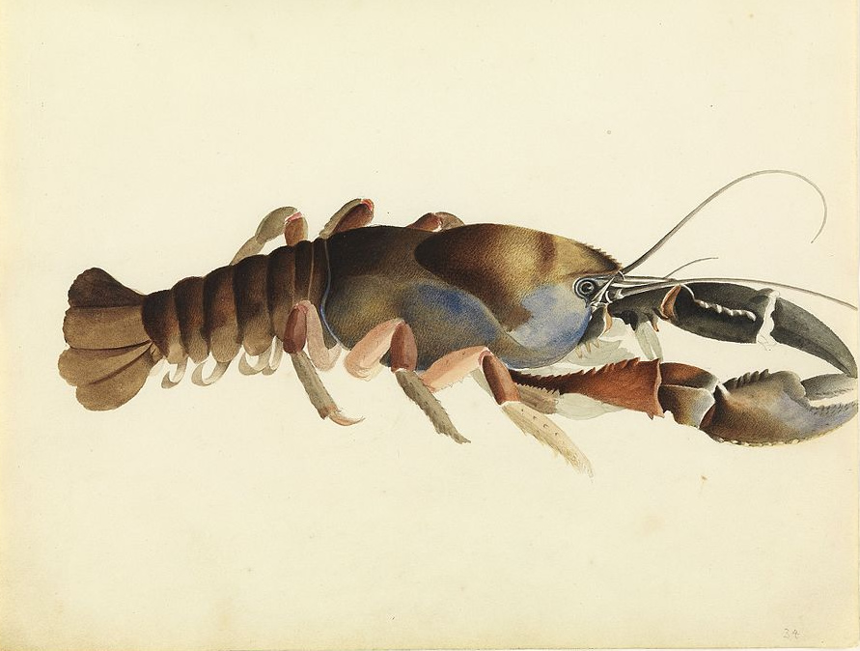
Crayfish Anatomy / Adaptations
Antenna
Abdomen
Cephalothorax
Antennule
Carapace
Tergum
Telson
Swimmerets
Uropods
Walking legs
Cheliped (claw)
Notes:
Crayfish Anatomy / Adaptations
Cephalothorax: joined thorax and head of crayfish and other arthropods
Abdomen: section behind the thorax covered in 6 plates
Tergum: name for the thickened plates on each segment of the body of crayfish and other arthropods; helps to protect soft interior
Carapace: hard upper shell of crayfish and other arthropods; protects the crayfish
Antenna: long organs used for touch, taste, and smell; helps to sense prey and predators in murky water
Antennule: shorter organs also used for touch and taste, as well as balance
5 pairs of walking legs to move along river or pond bottom (locomotion)
Cheliped: Fifth set of legs (closest to the head), enlarged with claws to hold food and provide protection
Chela: claw located at the end of each cheliped
Uropod: Last pair of abdominal appendages of crayfish and related crustaceans; found on sides of the telson, completing the tail fan used for swimming
Telson: An extension of the last abdominal segment; triangular-shaped structure found in between the uropods, completing the tail fan used for swimming
Swimmerets: small appendages on the ventral side (underside) of their abdomen; in males, they are used in mating; in females, they are used to hold eggs and baby crayfish
Image source:
Crayfish sketchbook illustration: https://commons.wikimedia.org/wiki/File:Sketchbook_of_fishes_-_34._Fresh_water_crayfish_William_Buelow_Gould,_c1832.jpg

Slide 5
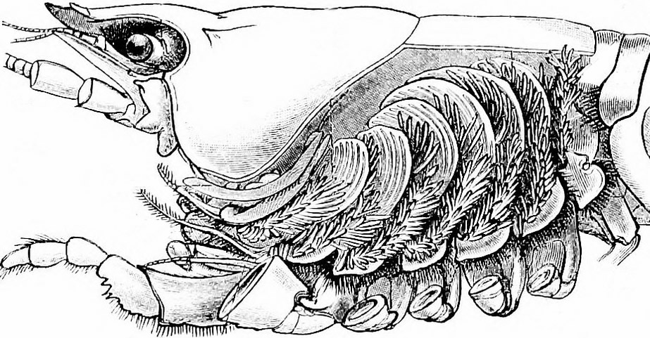
Cervical groove
Rostrum
Eye on eyestalk
Gills
Maxilla
Maxillipeds
Setae (hairs)
Notes:
Rostrum: beak-like projection; ask students what function might be; protects eyes, antennae, and antennules
Eyes on stalks: can be rotated for very large field of view
Cervical groove: indentation that separates head and thorax, which are connected in crayfish
Gills: extracts Oxygen from water; used to breathe
Maxilla: help draw water over gills
Maxillipeds: hold food; can touch and taste

Slide 6
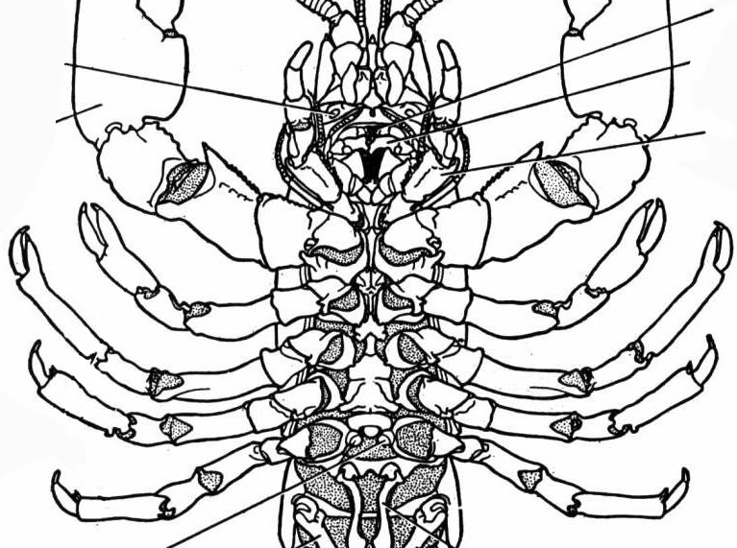
Ventral (bottom) view
Mouth
Green glands opening
Mandible
Third maxilliped
Cheliped
Genital pores
Notes:
Mandible: crushes food to be swallowed by mouth
Green glands: help to filter waste products and balance salt levels in blood; similar to kidneys in humans
Maxillipeds: hold food; can touch and taste
Genital pores: used in reproduction

Slide 7
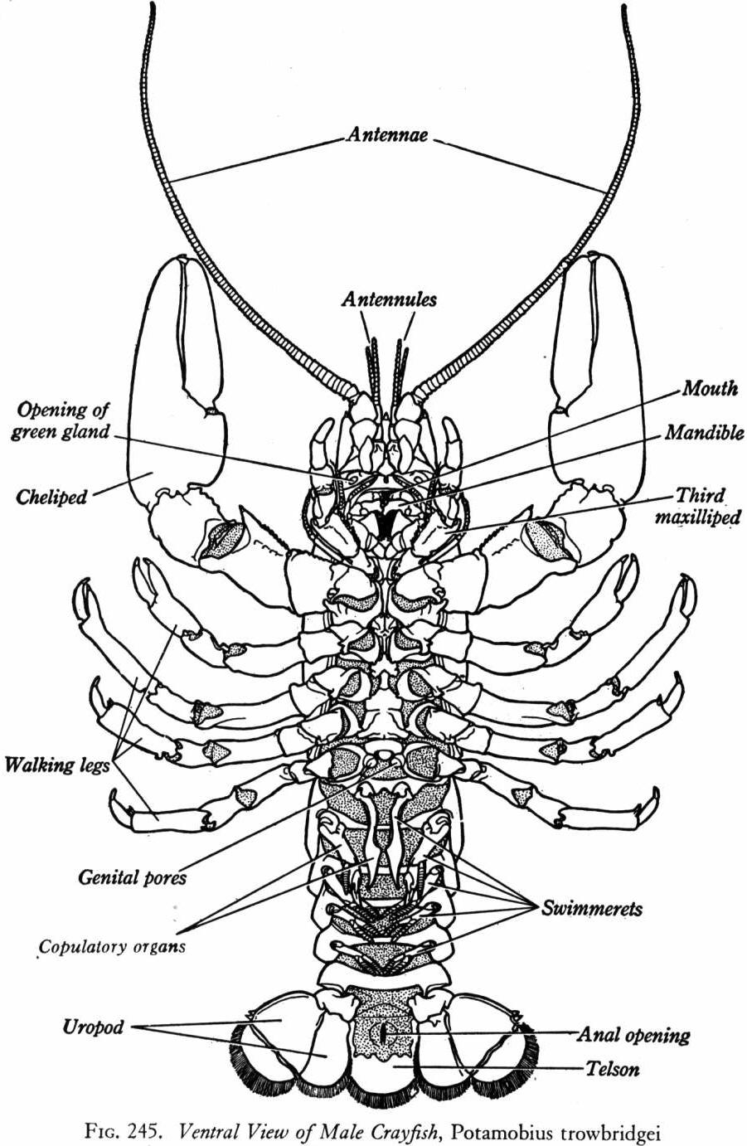
Notes:
Genital pores and copulatory organs used in reproduction
\

